Slide 1

Geoverse 3rd Annual
Partner Event
Welcome
December 9, 2020

Slide 2

Agenda: December 9, 2020
  1:00p ET: Welcome - 2020 Year in Review and What’s Next
  1:20p ET: Mobile Experts: Kyung Mun – Lead Analyst on Private LTE and CBRS
  2:00p ET: Video – Real World Success Stories - 7 Cedars Case Study
  2:10p ET: Solutions, Partners Program, and 2021 – Why Geoverse?
  2:55p ET: Conclusion – Helping You Do More
  3:00p ET: Adjourn

Slide 3





Today’s Speakers
Rod Nelson
CEO
Geoverse
Jim Jacobellis
VP Solution Partners
Geoverse
Bob Gault
Chief Commercial Officer
Geoverse
Allen Dixon
Sr. Director Channel Programs
Geoverse
Kyung Mun
Lead Analyst
Mobile Experts

Slide 4
1) Geoverse 2020 In Review and What’s Next
Rod Nelson – CEO, Geoverse
Bob Gault – Chief Commercial Officer, Geoverse

Slide 5





We deliver essential connectivity to places where network access is inconsistent or absent, enabling digitalization, digital inclusion, and network densification.
Private Networks
Rural & Broadband
Service Provider Solutions
Engineering
Network Operations 7x24x365
Customer Care & Technical Support

Slide 6
Geoverse is the largest neutral host operator in the U.S. and a leading interconnected private cellular provider
1,200+
CELL SITES
500
PHYSICAL LOCATIONS
350
EMPLOYEES
IN THE U.S.
~1.2m
UNIQUE RETAIL & WHOLESALE USERS
We are a subsidiary of ATN International [NASDAQ: ATNI]. For more than 33 years ATN has invested, owned, and operated communications companies & renewable energy assets.

Slide 7
We marry Private LTE/5G networks with major mobile operators’ networks for true mobility and connectivity for all
New Shared
Spectrum
[CBRS]
LTE Small Cells
Geoverse
Neutral Host & Interconnected Private LTE/5G
Permits enterprises to launch networks using cellular networking technologies
Low-cost LTE/5G small cell systems
GeoCore
GeoCore network platform is a trusted party between enterprise and major wireless carriers. Connect to GeoCore, and your building is connected.
GeoTrade
GeoTrade is a service management platform that provides insights into user experience and in-building analytics
First time application of blockchain to wireless services
One solution delivers two benefits:
  Neutral host: great connectivity for visitors and occupants with service from major carriers
  Private LTE/5G: a secure, high-performance network for enterprise & IoT applications. for any device with a Geoverse SIM card

Slide 8









Building Blocks for Private Cellular Networks to Deliver True Mobility and Connectivity for All
Interconnected Private Cellular &
Neutral Host Network
Licensed or
Shared (CBRS) Spectrum
LTE / CBRS
Small Cells and CBSDs
Geoverse
GeoCore
GeoCore powers your Private LTE/5G network and serves as a trusted party between enterprises and major public cellular carriers. Connect to GeoCore, and your enterprise is interconnected
GeoTrade
GeoTrade is a service management platform that provides insights into user experience and in-building analytics
Geoverse SIM Cards –
GeoCore Connected Devices
One private network,
Two key benefits:
Secure, high-performance network tailored to enterprise venue and user community
Neutral Host multi-carrier subscriber support
CBRS expansion of the cellular spectrum enables enterprises to launch wireless networks using cellular networking technologies
Low-cost cellular/CBRS small cells makes private Radio Access Networks (RANs) attractive

Slide 9
Network as a Service (NaaS)
CBRS radio equipment and related design and installation services…
+ | Geoverse GeoCore networking and GeoTrade management…
= | provides customers with fully interconnected Private LTE network with industry leading services and applications
Key Benefits
Industry best MNO Integration
Easy Deployment
Leading services including Voice
24/7/365 Support
Neutral Host Monetization
GeoCore Networking
Full function mobile core network including IMS
Metro GeoCore deployed in major metropolitan for lower latency than cloud deployed systems
Edge GeoCore deployment option for best latency and full enterprise control of user data
GeoTrade Management
View network configuration
Usage analytics
SLA scorecard
SIM Subscription Management
SIM Subscription Usage Reports

Slide 10
Operations and Support from Geoverse
Geoverse brings decades of cellular network operations and customer support experience to your private network
1
Network Operations Center
Carrier grade 24x7x365 monitoring and dispatch
4
Proactive Maintenance
Geoverse maintains close relationships with critical vendors to ensure all solution components stay current
10
This is Geoverse
2
Call Center
Contact center for end customer enterprise support
5
Network & Device Testing
Lab capabilities to test end-to-end interoperability of solutions from network to device
3
Tier 2 & 3 Technical Support
Engineering experts with deep solution expertise on call to troubleshoot and diagnose complex networking scenarios
6
Professional Services
Expertise for post operational optimization or expansion

Slide 11
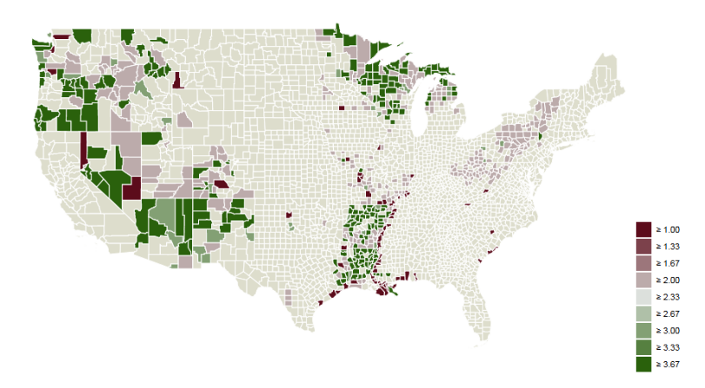




Geoverse GeoCore and CBRS PAL licensing footprints
Service offerings enhanced by both licensed and shared spectrum
PALs per
County
2
PAL Coverage Footprint
1569 – Total Licenses
590 – US Counties
21.8M – Population
847.3K – Physical area (Sq Miles)
3
4
*PAL=Priority Access License
Notes:
Removed cities we aren’t in yet – these are all newsworthy announcements. Please do not tell the media any unannounced cities.

Slide 12
GeoCore Cloud EPC – Private Cellular Platform Deployments
Ongoing Expansion to NFL Cities Across the US
GeoCore Cloud EPC Rollout
★ Seattle
★ Minneapolis
★ Chicago
★ Boston
★ Denver
★ Columbus
★ Northern Virginia
★ Bay Area
★ Las Vegas
★ Los Angeles
★ Dallas
★ Atlanta
GeoCore Cloud EPC Rollout
★ Locations in Operation
★ Locations in Deployment
★ Locations in Planning
★ Miami
Notes:
US States Map
This slide contains a map of the US. The map is comprised of individual states. The map is grouped, but ungrouping will allow you to select specific states as required. You can re-size and re-colour any element of the map using standard PowerPoint functions and formatting options.

Slide 13
Looking Ahead - 2021
Growth
  Investing in the Enterprise
  Raising awareness
  Getting focused
Channel led
  Capacity
  Competency
  Capability
Establishing meaningful relationships
  Healthy recruitment
  Less is more
  Build a program where you can make money
Building the story
  Customers
  Partners
  By vertical

Slide 14

2) Mobile Experts – Private LTE and CBRS
Kyung Mun – Lead Analyst
Kyung@mobile-experts.net

Slide 15



3) 7 Cedars Case Study
Video – 7 Cedars, Geoverse, Agility AVL, Orion Labs
Geoverse YouTube Channel:

Slide 16
4) Solutions, Partner Program, and 2021
Jim Jacobellis – VP Solution Partners
Allen Dixon – Sr. Director Channel Programs
Bob Gault – Chief Commercial Officer

Slide 17

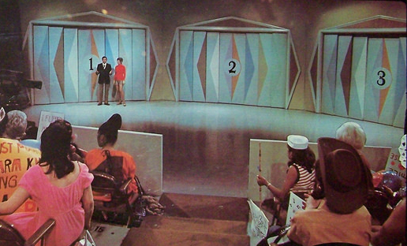

Wireless LAN & Wireless WAN - Decision Doors

Slide 18
Why “Not” Commercial Cellular…?
Coverage
Public cellular coverage and VPN service remains highly inconsistent for many target applications.
03. Cost
Carrier VPN/Private LTE oriented Solutions remain costly, plus, Digital Divide use case requires minimal OPEX.
Connectivity
Challenges
02. Not Enterprise/Gov Friendly
Considerable dislike due to years of mistreatment.
04. Data Privacy and Ownership
When Private LTE is provided by a public mobile operator - your data must be routed through the operator’s backend before reaching the end server or application platform. This results in lack of ownership and effects governance, security, and privacy.

Slide 19
Why “Not” Wi-Fi…?
Predictability of Wi-Fi
Wi-Fi is a best effort technology and not practical for certain applications requiring consistent Quality Of Service (QoS).
03. Coverage & Outdoor Performance
Typically, 5X+ fewer Radio Nodes with LTE.
Especially efficient and Cost Effective vs. Mesh Wi-Fi design.
Connectivity
Challenges
02. Security
LTE offers native security for radio link combined with SIM based Authentication.
Additional Security options for transport and application layer.
04. Spectrum Efficiencies
Many locations have congested Wi-Fi spectrum.
CBRS offers a 150 MHz open spectrum.

Slide 20
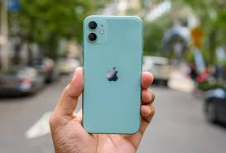

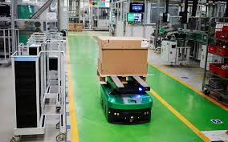

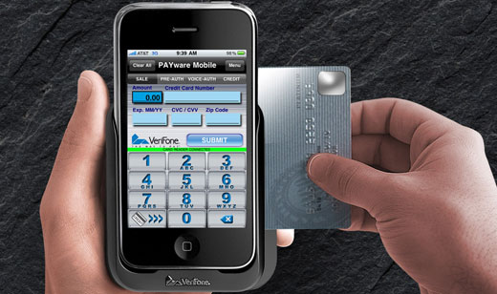





2020: Leading Applications for Private Cellular
Geoverse SIM Card
t

Slide 21



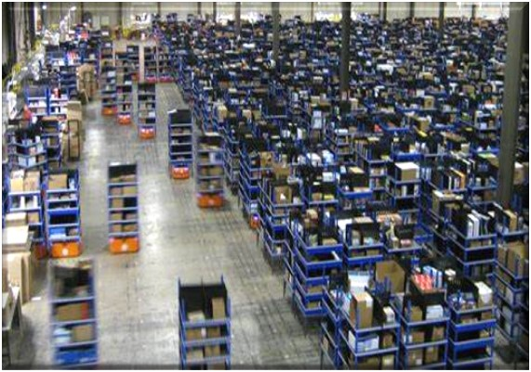
2021 Private Cellular Trends
Outdoor Deployments Will Continue to Rule
Fixed, Smart City, Virtual Learning leading the way
Digital Divide $ funding
New and abbreviated RF Planning process
Outsourcing Managed services including device support
Futureproofing thought process is prevalent
Transportation & Agriculture sector Emerge
In-Building and Campus
Industry 4.0
Private/Public use case acceleration

Slide 22
What’s Working in 2020 Will Continue in 2021
Not a Transactional Sale
Trusted Consultant Approach
Establish Best Practices Together to Deliver:
A clear understanding with access and management of different CBRS devices that enable the Enterprise & Government use cases.
Ability to complete RF Planning, backhaul, commission and deployment of RAN
Ability to Host, Monitor and Manage the RAN.
Ability to Host, Deploy, Commission EPCs and understand linkage into public cellular and other networks.
CBRS Knowledge, SAS Accounts and CPI Personnel.
Ability to host operations to support customers.
Edge and 5G applications for target industry segments.

Slide 23
Channel Transformation Journey
Industry Leading
Next Generation Ecosystem
New Business Models(SW & Services)
Full Management & Automation
Scale & Grow
Low-touch SKU-based
High-volume transactions
Services practice
Capex & Opex
Channel Sales Engine
Aligning for Growth
Building Capacity
Specializations
New Business- Deal Reg
Traditional Channel Model
Predominantly Fulfillment
Covering All Partners
Reactive
2000-2007
2007-2012
2012-2020
2021-

Slide 24
State of the Private Cellular Market
What’s Happening
Areas of Opportunity
Apparent Market Needs for Private Cellular
Cellular Partner early entrants
Ecosystem
Vertical adoption
Enterprise Networking Partner curiosity
Creating momentum and pipeline
Clear solution differentiation
Partner profitability as pricing unclear
Channel Self Service tools required
Partner Private Cellular practices & what’s required
Stratifying Partners
Scaling success
Mature Partner Channel & Training Program

Slide 25
Why Geoverse?
We are a mobile network operator selling private mobile networks
Not a hardware manufacturer operating a network to sell radios
Experience, expertise, and relationships developed over years
We can provide Voice – VoLTE – via IP-PBX integration
  One number
  Native dialing
We have carrier-grade service and support
  24x7x365 monitoring
  24x7 call center support

Slide 26
Multiplier Effect Through Channels
Maximum coverage for Growth
Ecosystem/ OEM
Ecosystem
CSP/SP
Networking Partners
Resellers
Cellular Resellers
Sales Agents
Agents
(Master, Distribution & Individuals)
FY20
FY21
Partner Coverage: 1:few, 1:many and geographic

Slide 27
Geoverse Partner Program(GPP) Strategy
Objectives
Mgd Svc Providers
Geoverse Partner Program Program (GPP)
Volume & Value
Program simplification
Partner Practice
Rewards
Discounts
TCO
Training
Deal Protection
Economic
Resellers
w/SI
Enablement
Engagement
Benefits
Agents
Partner differentiation
Branding
PoC
New Revenue Streams

Slide 28


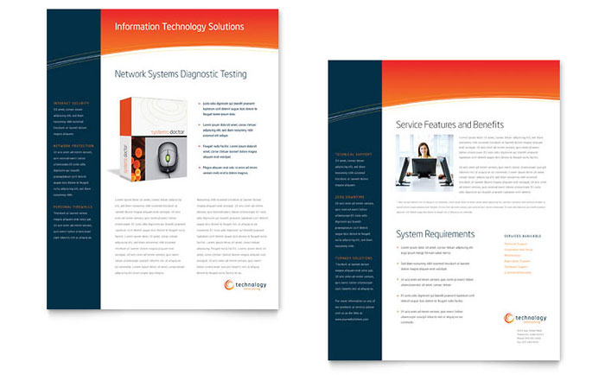

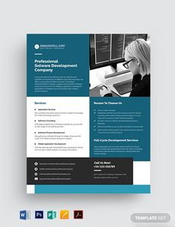

GPP Partner GTM/TCO Benefits
Proposal Based MDF
Full-Service Proposal Support
RF Design Tools and Resources
Inside Sales as a Service
Private Cellular (LTE) Sales Kits
Deal Registration

Slide 29
Training - In Development
Training/certification program
  Understanding and selling the Geoverse private cellular solution
  Understanding and using the resources/tools available
  Understanding and using the deal process

Slide 30
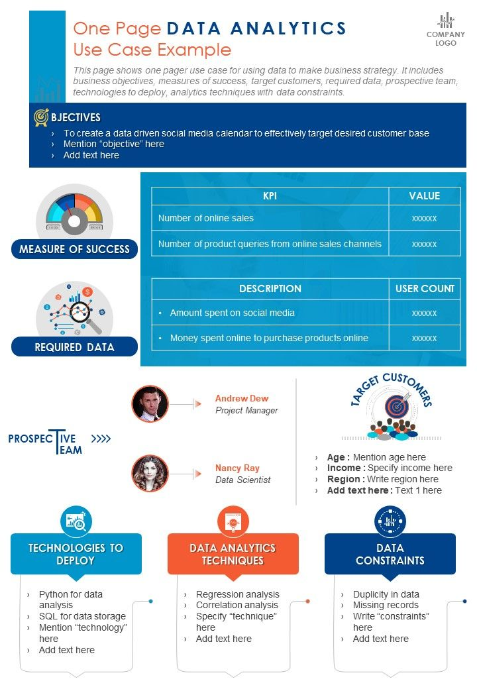
Solution Services GTM Toolkit
…is for Channel Account teams…
…whose partners have invested in Geoverse to deploy private cellular solutions …
…to understand Geoverse GTM capabilities and guide a GTM engagement with you.
Talk to your Channel Account Manager today!
Notes:
The Toolkit is for Partner Account teams whose partners have invested in Geoverse to Private Cellular services to understand Geoverse’s GTM capabilities and guide a GTM engagement with their partner.

Slide 31
Room under the tent
Geoverse
Enterprise
Agents
3POs
Integrators
Contractors
Distributors
VARs
Application Providers
MSOs
MNOs
OEMs

Slide 32
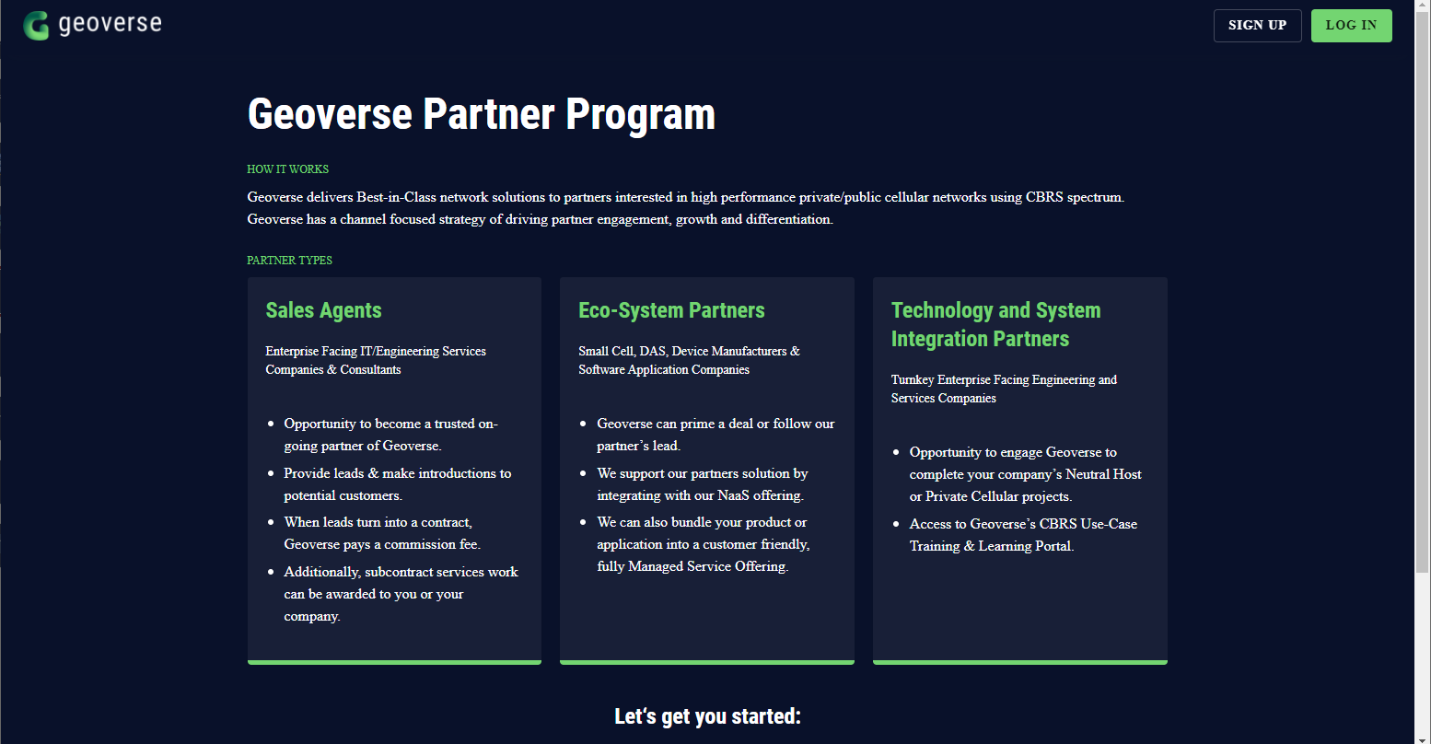
NaaS Demo - Portal

Slide 33
Partner Revenue Pools
NaaS | Partner
Plan RAN | $
Design RAN | $$
Implement onsite equipment | $$$
RAN management | $
Onsite maintenance & support | $$
GeoCore EPC software subscription | $$
SIM card subscriptions | $$$
User devices | $
Use cases/applications | $$$

Slide 34
Summary
We are declaring a position
Opportunity exists for all different type of business models
Launching Geoverse Partner Program to grow at scale
Investing in broad range of resources to support and simplify the process
Set-up to win in 2021

Slide 35
5) Conclusion and Wrap Up
Bob Gault – Chief Commercial Officer

